Slide 1
MINOR PROJECT – I
HAND MOTION BASED MESSAGE CONVEYOR FOR PARALYTIC PATIENT’S ASSISTANCE
MENTOR NAME: GROUP MEMBERS:
DR. BAJRANG BANSAL ESHA MAHENDRA
HARSHITA MADAN
SHIVANGI GUPTA

Slide 2
INDEX:
Introduction
Literature Survey
Project Basics
Schematic Diagram
Components Required
References

Slide 3
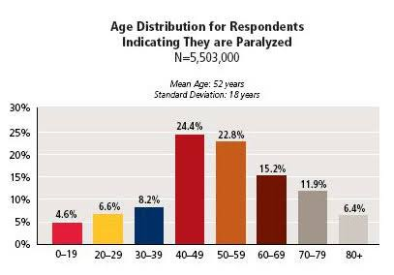
Motivation
PROBLEMS FACED BY PARALYTIC PATIENTS:
They cannot move from one place to another on their own.
They cannot fulfil their basic needs like eating and drinking by themselves.
They need a caretaker always.
Age Distribution for Respondents Indicating They are Paralysed

Slide 4
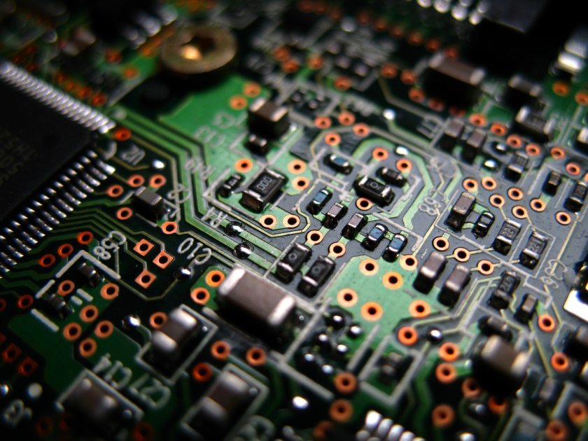
WIRELESS COMMUNICATION IS THE TRANSFER OF INFORMATION OR POWER BETWEEN TWO OR MORE POINTS THAT ARE NOT CONNECTED BY AN ELECTRICAL CONDUCTOR.
THE MOST COMMON WIRELESS TECHNOLOGY USE RADIO FREQUENCY THAT CARRY INFORMATION BY MODULATING PROPERTIES OF ELECTROMAGNETIC WAVES.

Slide 5
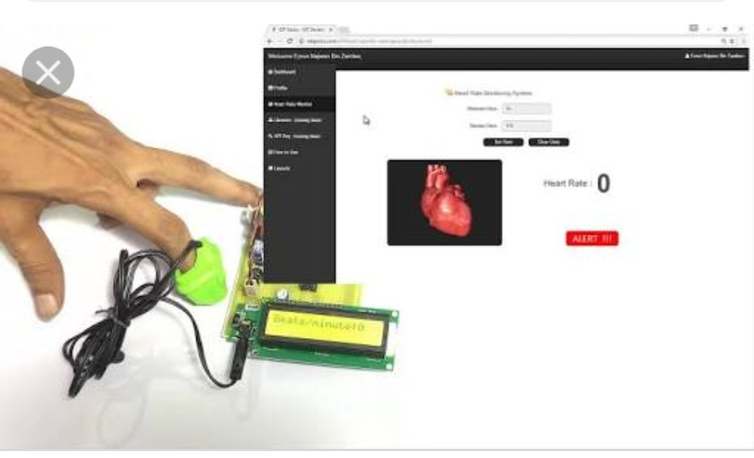
PREVIOUSLY DONE WORK IN THIS FIELD :
1.Heart attack detection monitoring system
This proposed system uses sensor that allows to detect heart rate of a person using heart beat sensor even if person is at home.
After setting high and low level of heart beat limit, system starts monitoring and if limit exceeds it sends alert to controller which then transmits over internet and displays message at IOT gecko.

Slide 6
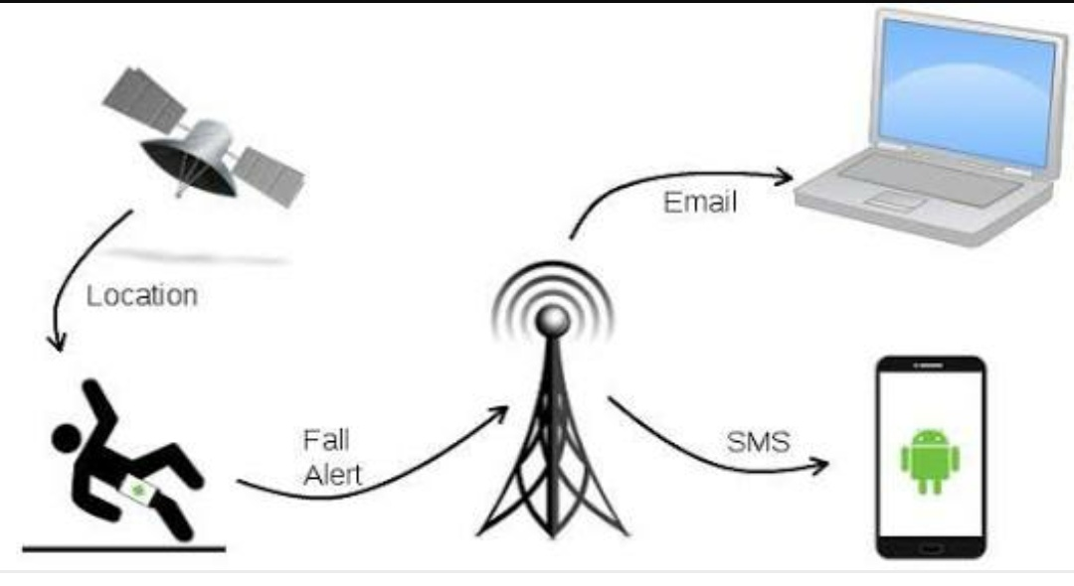
2.IOT based wheelchair fall detection system
This proposed system is developed to prevent patient falling from wheelchair by adding sensor technology to it.
The communication between chair alarm and the person monitoring is done through WI-FI network.
Patients gestures like leaning back or forth is evaluated by capacitor and pressure sensors and transmits this information via ZigBee and USB.

Slide 7
OUR PROJECT :
The main aim of the project is to establish communication between paralytic or disabled patients and a nurse.
It makes use of hand motion recognition circuit and a receiver and a transmitter circuit.
The communication is established by tilting the device placed on the hand of a patient.
This idea focuses on building a smart system to make patients self-sufficient.

Slide 8
To detect hand movements, accelerometer+ gyrometer will be used which will transmit information wirelessly over NRF to the receiver.
The device will detect the following hand gestures:
Upward Movement -> Need food
Downward Movement->Call doctor/relative
Left Movement-> Need Water
Right Movement->Switching ON/OFF the light/fan

Slide 9
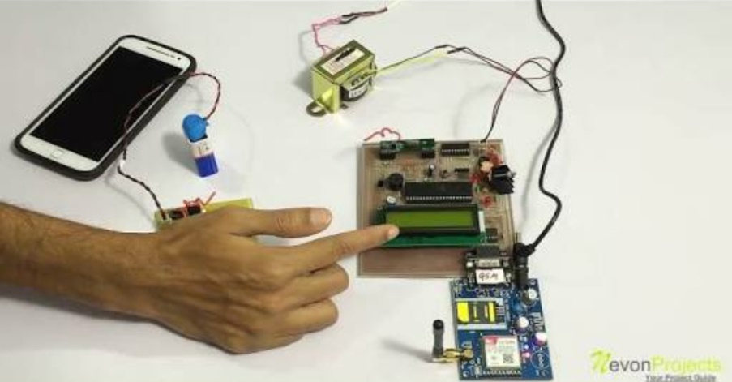
This way after the patient sends the message, the nurse can respond and provide assistance.

Slide 10
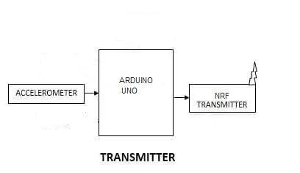
BLOCK DIAGRAM OF TRANSMITTER

Slide 11
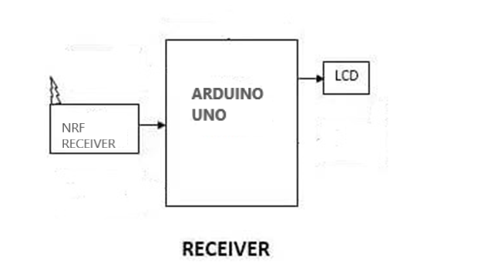
BLOCK DIAGRAM OF RECEIVER

Slide 12
HARDWARE USED:
Arduino UNO
MPU6050 Sensor
NRF Tx Rx
LCD
Bread boards
Jumper wires
SOFTWARE USED:
1. Arduino IDE

Slide 13
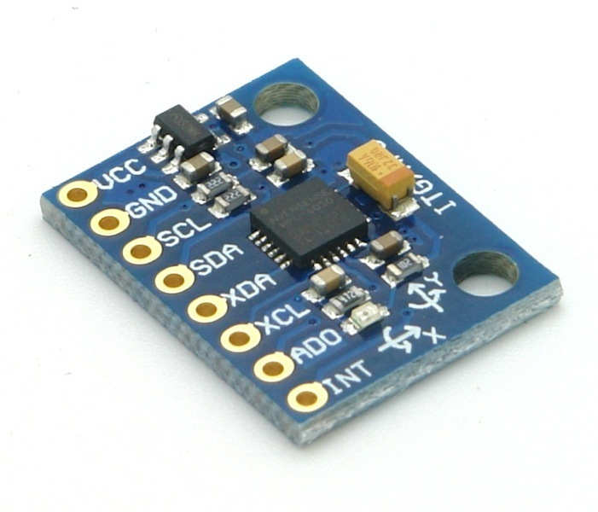
MPU6050 MODULE
6-axis motion tracking device
3-axis Gyroscope,
3-axis Accelerometer
Digital Motion Processor
On-chip temperature sensor all in small package.
It will detect hand movements and will communicate with the microcontroller.

Slide 14
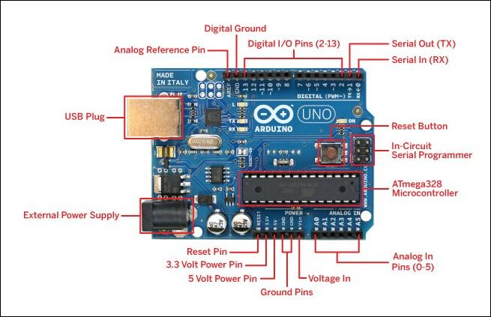
ARDUINO UNO
The Arduino Uno is a microcontroller board based on the ATmega328P. It has 14 digital input/output pins (of which 6 can be used as PWM outputs), 6 analog inputs, a 16 MHz ceramic resonator, a USB connection, a power jack, an ICSP header, and a reset button.
Operating voltage: 5V, DC current per I/O pin: 20 mA, Flash memory: 32KB.

Slide 15
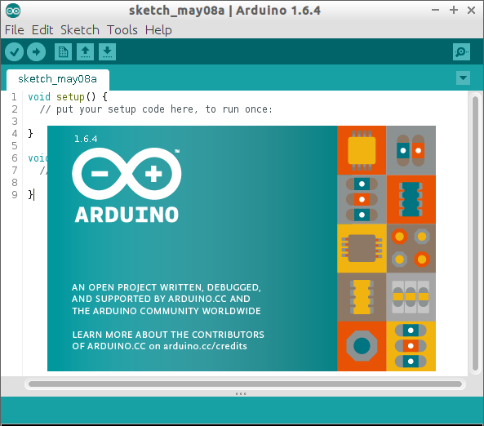
HOW IS ARDUINO UNO PROGRAMMED ?
Arduino UNO is programmed using ARDUINO IDE software by writing code, verifying and uploading.
Communication is done with the help of COM Ports.
The required output can be seen on its serial monitor.

Slide 16
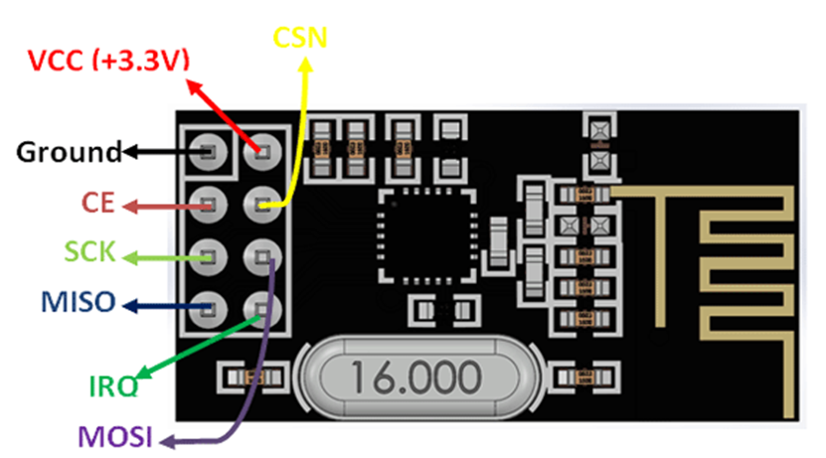
NRF MODULES
SPECIFICATIONS NRF 24L01- 2.4 GHZ RF TRANSCEIVER:
Low cost single-chip 2.4GHz RF transceiver IC
Range with Antenna: 250Kb rate (Open area) >1000 meter
Power: Ultra low power consumption
Input Voltage: 3.3V
Pins: 5V tolerant

Slide 17
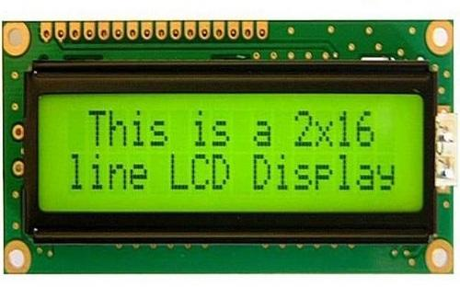
HOW IS MESSAGE DISPLAYED ?
LCD is interfaced with the Arduino which displays the message received by it.
LCD should be in write mode to display data received by data pins.

Slide 18
CONCLUSION:
This device has made conveyance of message possible only by the motion of a hand movement. The ease of message conveyance is the main advantage of this system.
By implementing this system a simple device for paralyzed people can be achieved without the use of complex form of inputs.
Our system successfully proves that this system is an excellent approach to be implemented at hospitals for patient-nurse communication. The project can be further developed into an automatic wheel chair wherein the wheelchair will be moved just by hand gesture.

Slide 19
REFERENCES
http://nevonprojects.com/
http://electronicwings.com/
Pughazendi N; Sathishkumar R;International Conference on Energy, Communication,Data Analysis And Soft Computing (ICECDS-2017)
http://researchgate.com/
Shreedeep Gangopadhyay; Somsubhra Mukherjee; Soumya Chatterjee; Proceedings of Fifth IRAJ International Conference,15th September 2013,Pune,India http://pjrc.com/teensy/td_libs_time.html/

Slide 20
THANK YOU!

